Slide 1









EC2 Instance
Streamlit
Real-time Dashboarding
Kafka Producer
Flight Tracking DB (JSON)
Amazon
Managed Service for Grafana
Snowpipe Streaming
Snowflake
Kafka Connector
Amazon
Managed Streaming for Kafka
Amazon
QuickSight
(Historical)

Slide 2
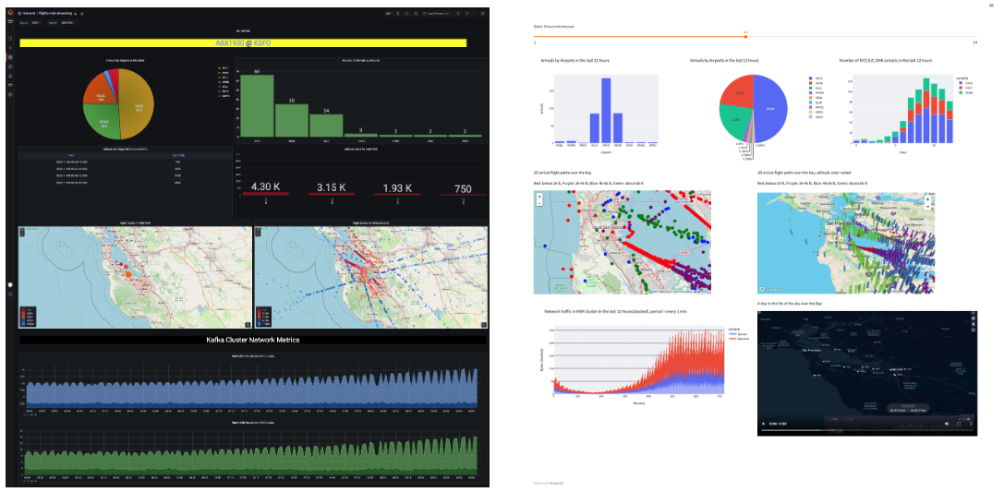
Amzaon Managed Grafana
Streamlit

